Slide 1
PROJECT TITLE DEVELOPMENT OF ATC MAP MOBILE APPLICATION
NAME: DAVID S. MACHIBYA
ADMISSION NUMBER: 19050513009
DEPARTMENT: INFORMATION COMMUNICATION
TECHNOLOGY
BACHELOR: COMPUTER SCIENCE

Slide 2
OBJECTIVES
MAIN OBJECTIVE
To develop ATC Map Mobile Application to help visitors and freshers navigate the College and nearby social services.
SPECIFIC OBJECTIVES
To collect user requirements
To design the ATC Map mobile application
To implement the ATC map mobile application
To validate the ATC Map mobile application if it meets the requirements.

Slide 3
SCOPE
The mobile application is focused on solving the problem of navigating campuses or institutions by using ATC as a case study.
The system have the following core functionalities.
Map of Arusha Technical College and nearby locations labelling offices, buildings, and other important areas.
Provide a panel for users to comment and rate services available on the map.
Provide directions from one of the areas found on the map to another

Slide 4
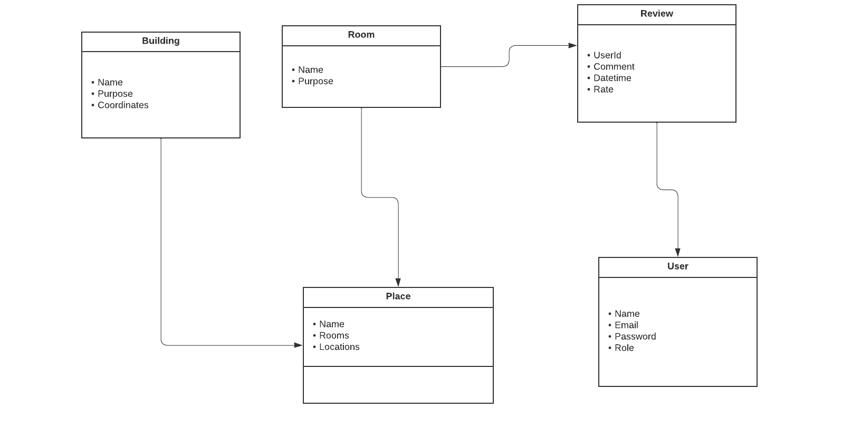
Database Design

Slide 5
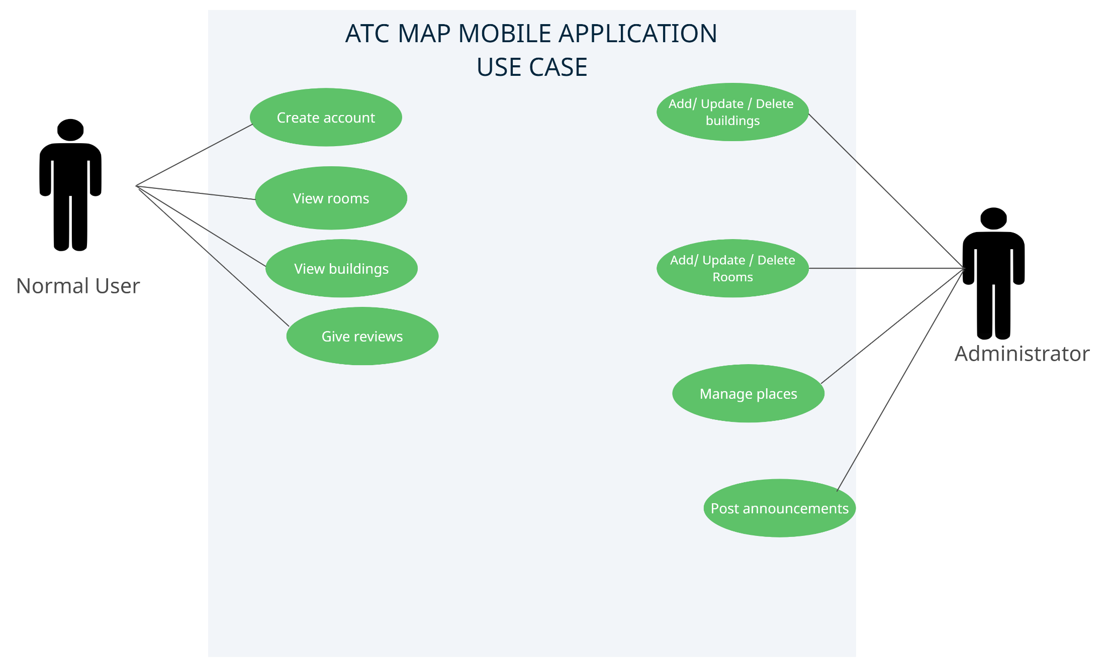
Use case diagram

Slide 6
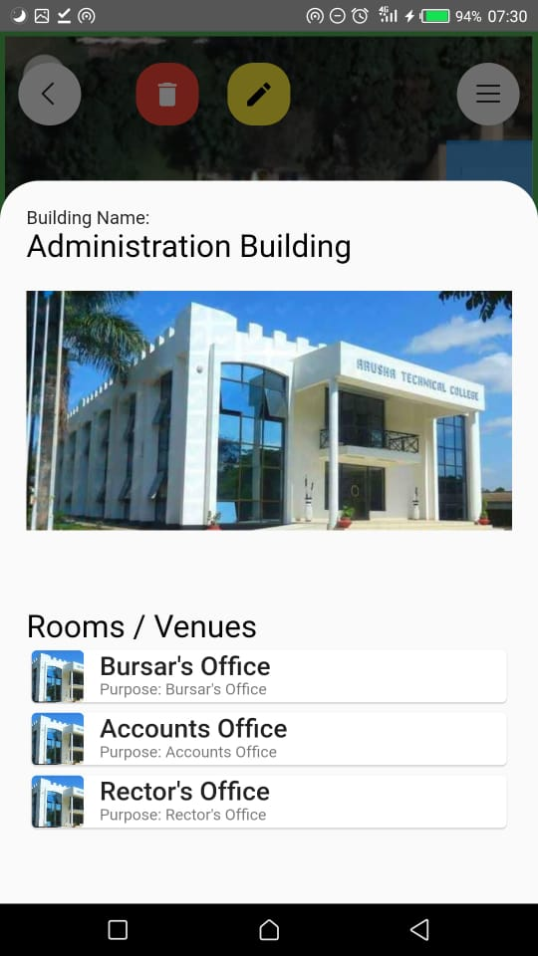
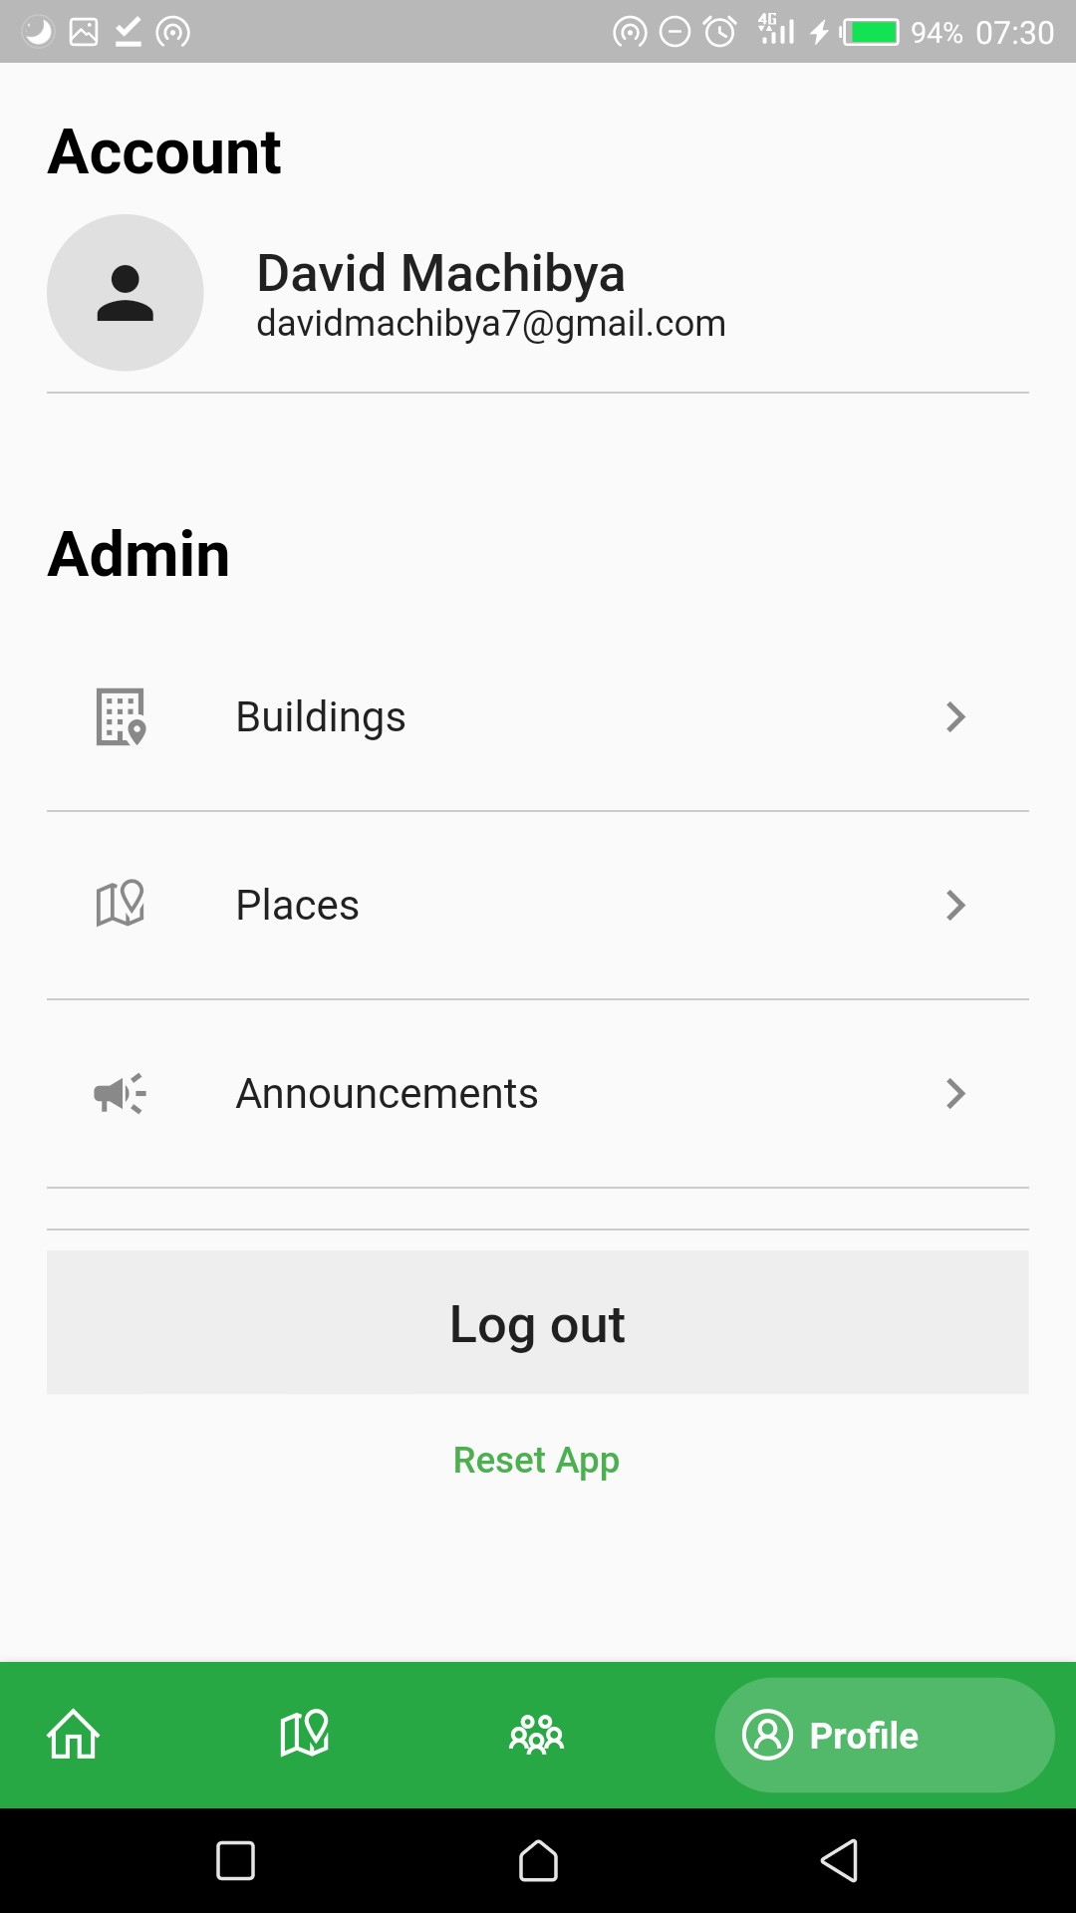
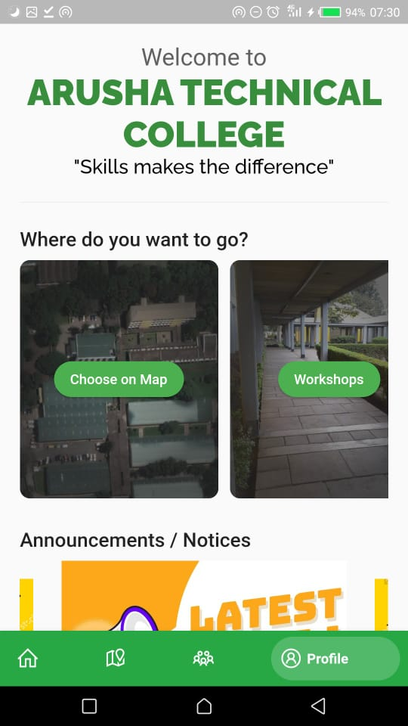

Slide 7
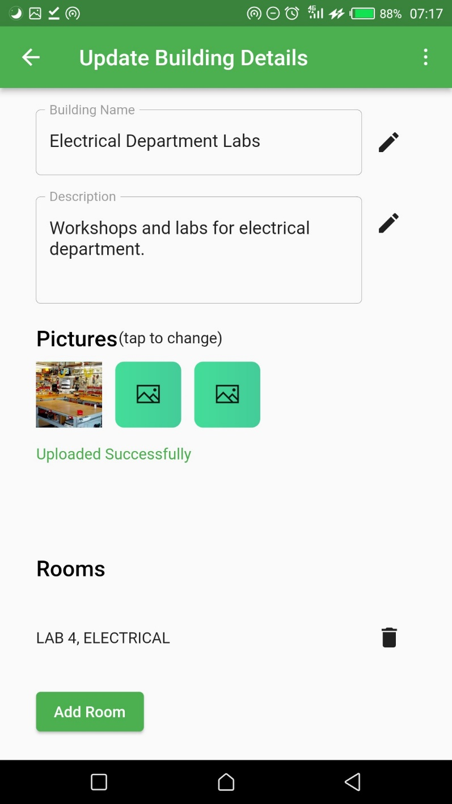
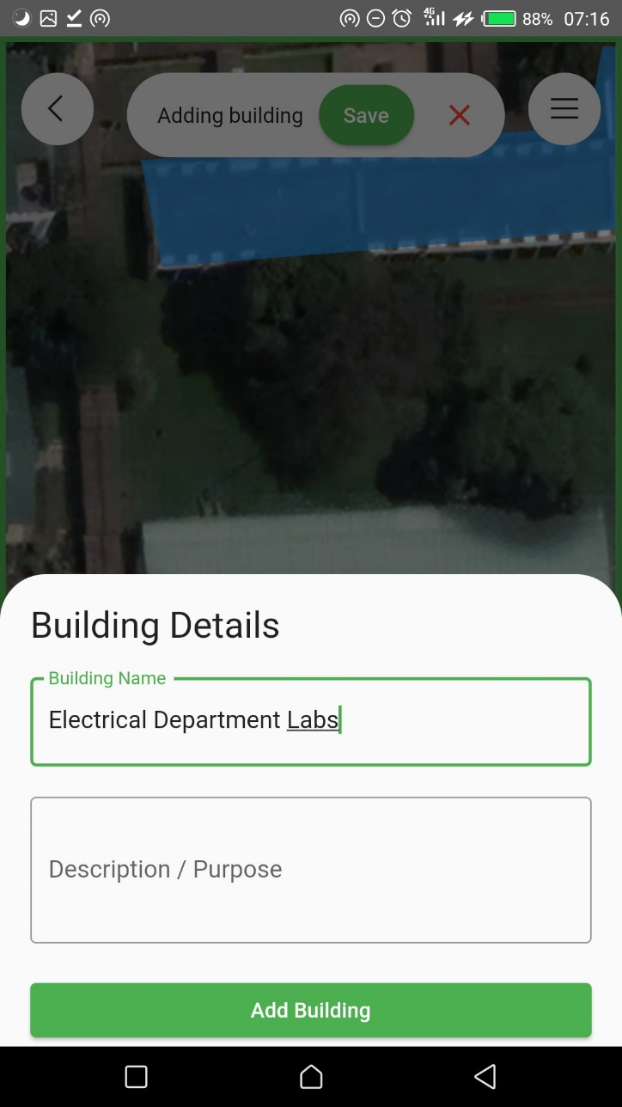
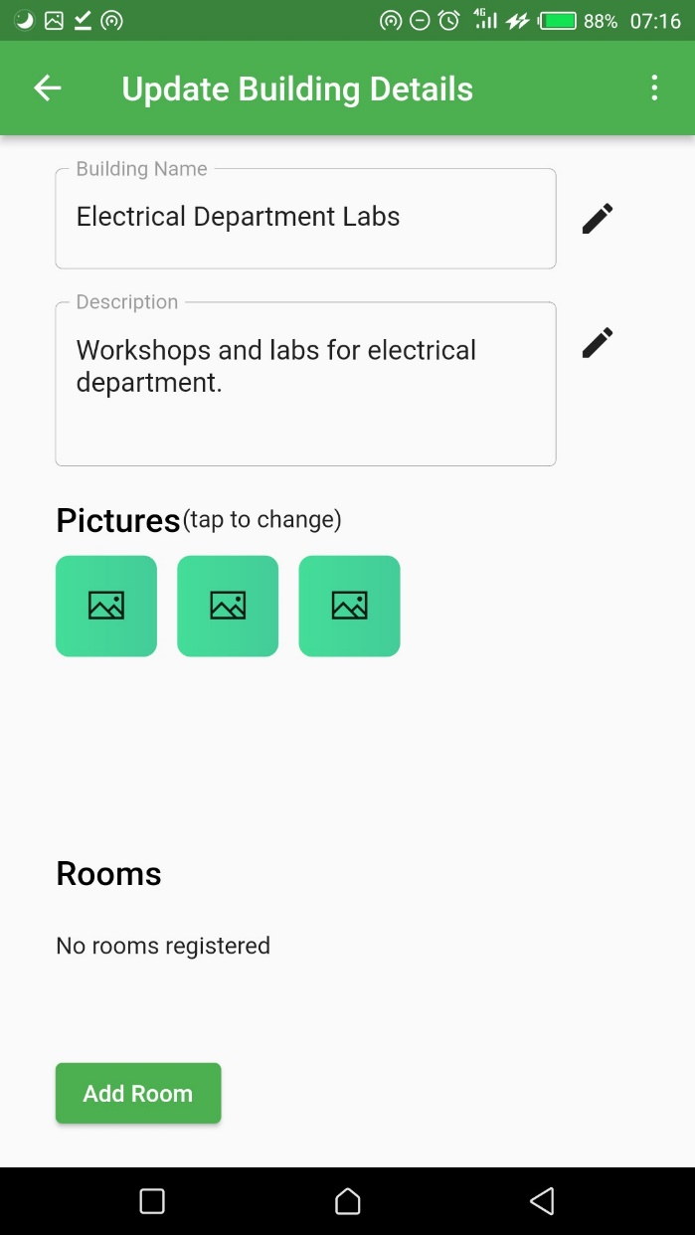

Slide 8
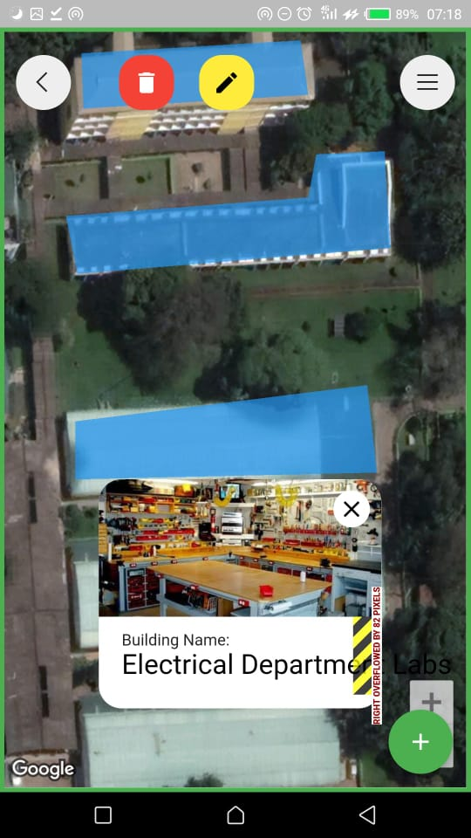
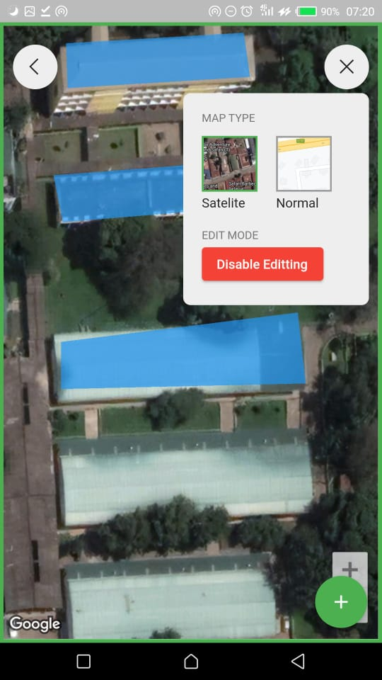
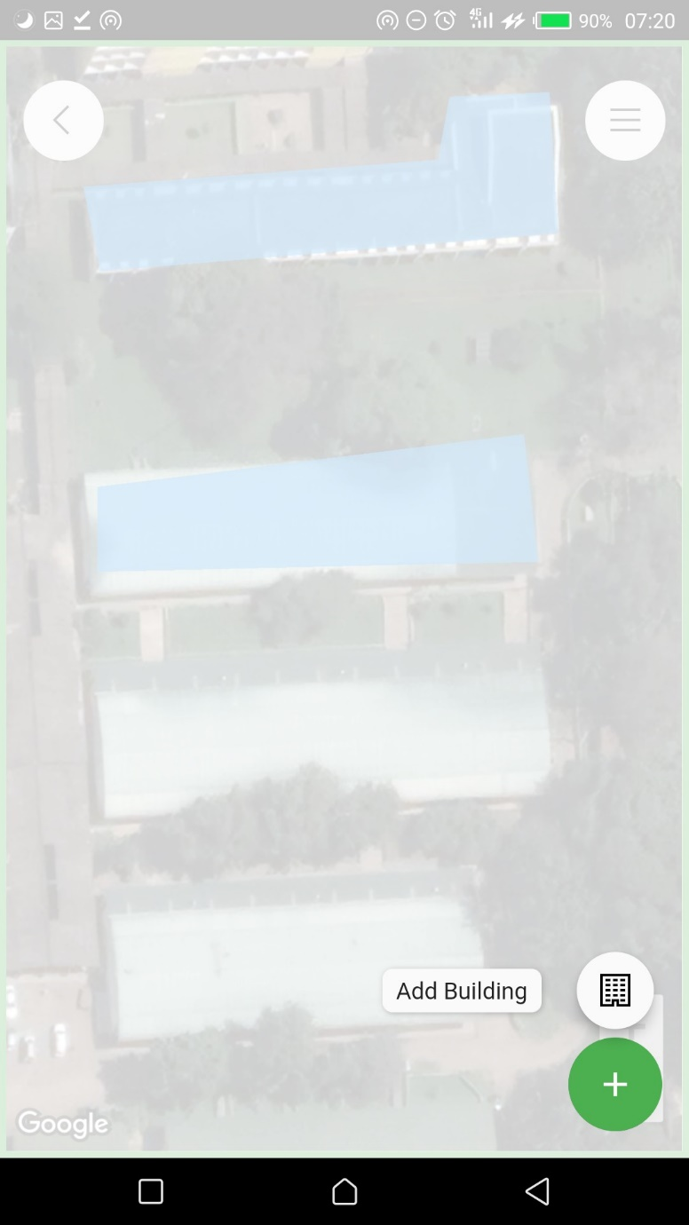

Slide 9
RECOMMENDATION
In the upcoming app releases I recommend that all users have the ability to add new places, rooms or buildings with some verification criteria so as to make possible to cover much more places.
In the future a web version of the app should be built so as to allow people with computers and other computing devices to access the system.

